Slide 1
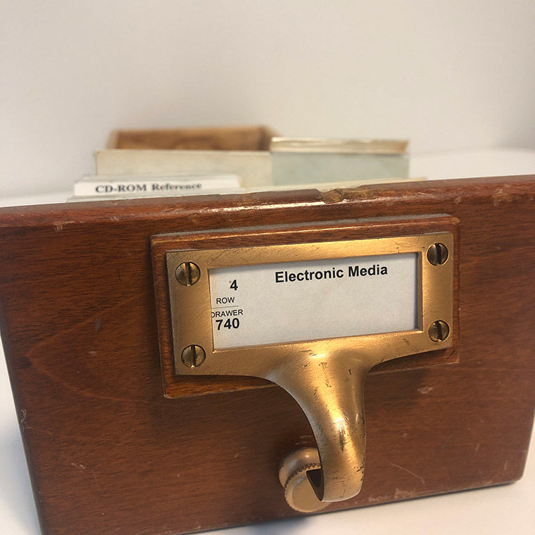
Remote Art History Research
at the Graduate Center during COVID-19
Alycia Sellie
Associate Professor and
Liaison Librarian for Art History
October 23, 2020
Notes:
Images in this slide show are from: https://www.metmuseum.org/blogs/in-circulation/2020/molisci
These slides have WAY TOO MUCH TEXT! But I wanted everyone to be able to come back and use this document later, share it with those who could not attend, and to have information and links all outlined together in one place.

Slide 2
Librarianship is full of acronyms
Use the zoom chat to remind me if you hear any terms that are unfamiliar to you or to revisit any acronyms
ILL
Interlibrary Loan, system of borrowing materials from outside CUNY
CLICs
System of lending and borrowing between CUNY schools
NYPL
New York Public Library

Slide 3
The Graduate Center Library is
Open Online Reopening = people
Scanning and print pick up = people

Slide 4
Phased reopening plans:
The GC Library is in Service Stage 0
Next phase: returns and scanning
We are beholden to the health and safety guidelines of the GC building management, CUNY, and New York City and State and our unions. Libraries are not essential services according to state guidelines.
We are working toward book pick up services, but when we do so we likely will only have access to print items from the Graduate Center Library, not ILL or CLICs.
Other libraries need to reopen for us to be able to borrow outside GC collections (and many libraries with curbside services are still limiting access to their local communities)
At our last count from 2018-2019, the GC Library owns just over 213,000 monograph print titles, which includes our reference collection and other items that do not circulate
We also would only be able to circulate those items which are currently checked in—our first phase is going to be to start allowing people to return items (which have been checked out since March!) and to figure out how to properly quarantine these items

Slide 5
IN THE MEANTIME! What does “open online” mean for you?

Slide 6
Ebooks: via Graduate Center Collections
How to find Ebooks:
OneSearch: The library’s catalog and “discovery layer”
Why would you search for books or ebooks in OneSearch vs. WorldCat?
OneSearch will show you what we hold at the GC and CUNY—so if you want to know what you can access immediately
WorldCat will show you hypothetically all that is published—if you are working on a lierature review and want to see EVERYTHING
What does OneSearch do well? What doesn’t it do?
Databases A-Z
Which includes icons for databases included in OneSearch:
Ebooks Research Guide
*Additionally: do you teach at another CUNY campus or another university system? CUNY campuses each have different ebook and database holdings; remember to search these separate catalogs for ebooks as well.

Slide 7
Credentials for Ebooks
OneSearch: use CUNYfirst username and password
Logging in allows you to see your account information (during COVID closures, what books you have checked out but items will automatically renew until you hear a call to return books)
While searching in OneSearch, if you log in, you can see additional search results
Databases, Ebook Collections: use GC Network ID credentials
GC Network Account Password reset tool
And beyond ebooks, a good link for CUNY account information

Slide 8
Ebooks: via Interlibrary Loan (ILL)
ILL is still fully operational via our ILLiad system while we are open online, but we are only delivering items electronically.
We’re relying on partner libraries who can send items while they work from home or libraries that are in work circumstances where they can safely scan
Any item can be requested, regardless of whether the GC or any CUNY school owns a copy.
Book chapter requests are often more successful than requests for whole ebooks during COVID
Publishers’ pages describing the book, Google Books previews, or even Amazon’s “see inside!” are all ways to see tables of contents in order to know what to request.
Our ILL department is really wonderful--email them or leave notes in your request if you have questions!

Slide 9
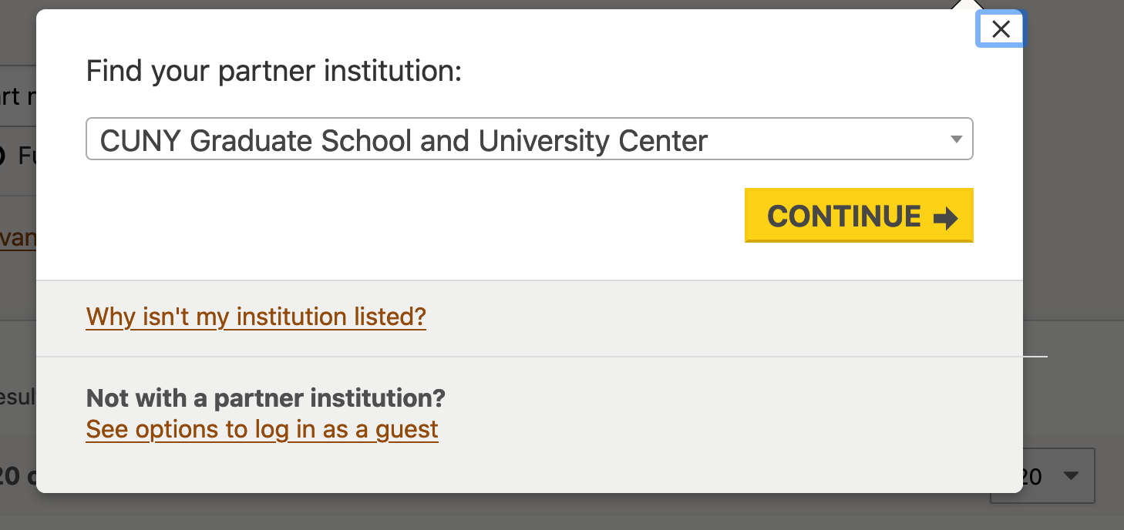
Ebooks: via Hathitrust Emergency Access Service (ETAs)
Large corpus of scanned items in the public domain (published before 1925) available to all
Special access for GC affiliates for in-copyright works (ETAs) only while print collections are inaccessible; 50% of the GC Library’s collections are available via controlled digital lending--but you must log in to see these ebooks.
Hathitrust ETAs DO NOT appear in OneSearch. In order to search these collections you need to log in at Hathitrust.org

Slide 10
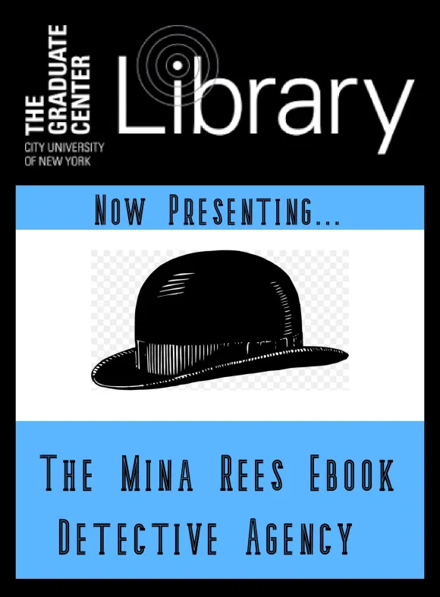
Ebooks: via the Ebook Search Service
Place a request and we will search all available collections at the GC, NYPL, and beyond and let you know what options are available--usually within a few business days.

Slide 11
Ebooks (and more): via the New York Public Library (NYPL)
See our NYPL research guide for links and updates
Getting a NYPL Card
SimplyE app for digital materials (quickest!)
OR
Email Alycia for instructions on how to get a barcode remotely (NYPL is working on a new system, current process is too inelegant for this slide!)
Book Delivery Services
Grab and Go Services
MaRLI by Mail
Databases and Ebooks
List of Databases (includes scholarly ebook collections like Cambridge, Oxford, Project Muse)
Ebook Collections Overview (includes audiobooks and popular literature ebook collections)

Slide 12
Articles and Journal Searching
If you have a citation for an article and are looking for the full text, the Journals Finder tool is the most accurate way to search across all of our databases to find (print and) electronic journals we hold at the GC.
Search in this tool by the title of the journal (not the title of the article) or ISSN
You’ll see a list of our databases that hold that journal, according to the dates of our subscriptions
You can go confidently to place an ILL request if you do not see any results in this search (or if you only see links to our print collections)

Slide 13
Art History Resources
GC Art History Research Guide
Also links to many other guides and resources
Almost every academic library that has an art history program would have a guide like this on their website; you can search the web for other guides to see how they contextualize research in this area or what resources they list.
With Alycia:
Schedule a research consultation to walk through a research question, tool or approaches together
Help via email: asellie (at) gc.cuny.edu

Slide 14
Additional GC Library Online Services
24 hours/day, 7 days/week online chat service
Not always GC or CUNY librarians, but we review every chat
Workshops and Events:
Reoccurring workshops:
Zotero
Open Access and Scholarly Communication topics
Grants and Funding
Chat with the Chief Librarian (monthly)
Other events and Conversation series
Research Guides
This page about Online Archival Research might be of special interest

Slide 15
Tools for Organizing Online Research
Organizing files and ideas
Zotero for citation management
Evernote for notes
Scrivener for writing
Tropy for organizing images and notes
Reading electronically
Drawboard app that lets you write on PDFs (many others to explore, but one I have heard good reviews about)
Distraction avoidance techniques (is this even possible?): turn off your internet connection while you are reading?

Slide 16
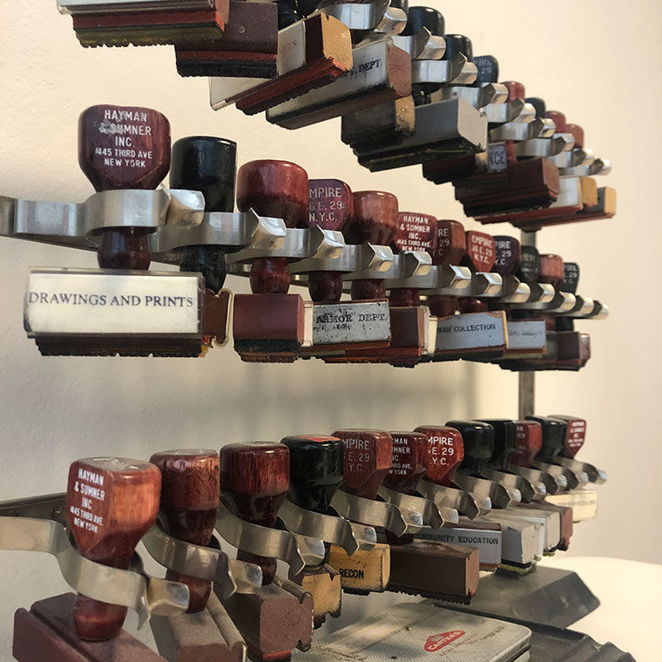
Thank you!
Please do get in touch:
Alycia Sellie asellie@gc.cuny.edu

